Slide 1
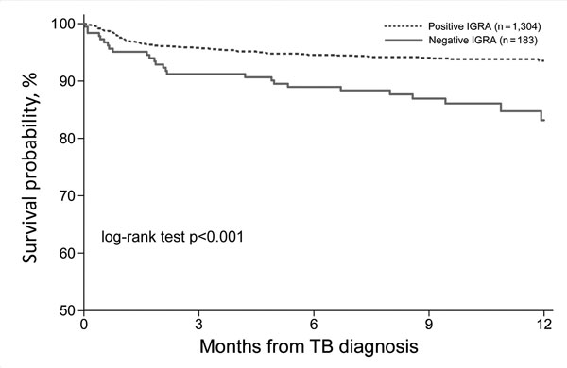
Figure 2
Figure 2. One-year survival from date of TB diagnosis for culture-confirmed TB, stratified by IGRA result, Texas, USA, 2013–2015. IGRA. IGRA, interferon-γ release assay; TB, tuberculosis.
Nguyen DT, Teeter LD, Graves J, Graviss EA. Characteristics Associated with Negative Interferon-γ Release Assay Results in Culture-Confirmed Tuberculosis Patients, Texas, USA, 2013–2015. Emerg Infect Dis. 2018;24(3):534-540. https://doi.org/10.3201/eid2403.171633

