Slide 1
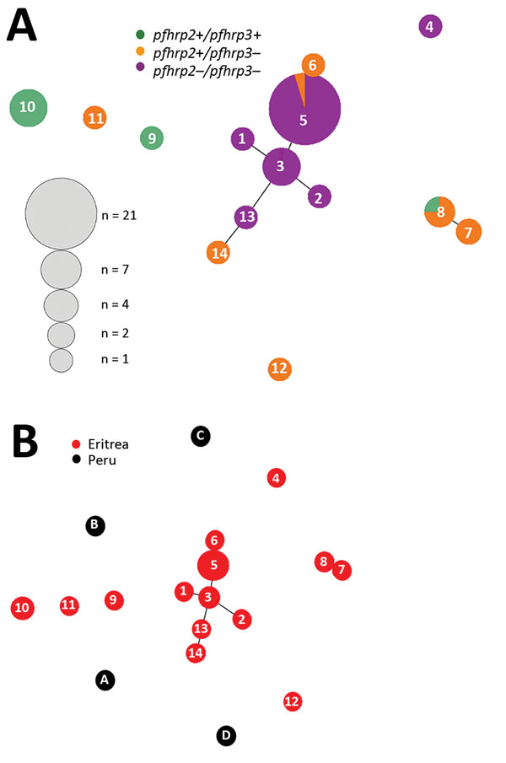
Figure 5
Figure 5. Genetic relatedness among Plasmodium falciparum parasite populations in Eritrea differing in pfhrp2 and pfhrp3 gene status (A) and comparison of parasite populations from Eritrea and Peru (B). Plots were produced by using Phyloviz software (24) at a cutoff value of 2 (minimum differences for 2 loci). Numbered circles indicate specific haplotypes. Circle sizes indicate number of samples with a particular haplotype. pfhrp, P. falciparum histidine-rich protein; – negative; +, positive.
Berhane A, Anderson KF, Mihreteab S, Gresty K, Rogier E, Mohamed S, et al. Major Threat to Malaria Control Programs by Plasmodium falciparum Lacking Histidine-Rich Protein 2, Eritrea. Emerg Infect Dis. 2018;24(3):462-470. https://doi.org/10.3201/eid2403.171723

