Slide 1
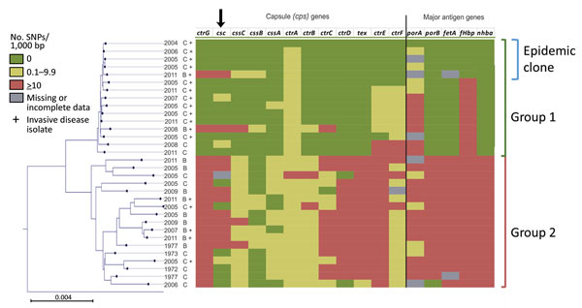
Figure 2
Figure 2. Genetic diversity within capsule and major antigen encoding genes among 32 Neisseria meningitidis clonal complex 4821 isolates, China, 1972–2011. Gene sequences from 32 clonal complex 4821 isolates were compared with the epidemic reference strain 053442 (the topmost isolate on the juxtaposed core genome phylogenetic tree). Scale bar represents total substitutions per site. SNP, single-nucleotide polymorphism.
Guo Q, Mustapha MM, Chen M, Qu D, Zhang X, Chen M, et al. Evolution of Sequence Type 4821 Clonal Complex Meningococcal Strains in China from Prequinolone to Quinolone Era, 1972–2013. Emerg Infect Dis. 2018;24(4):683-690. https://doi.org/10.3201/eid2404.171744

