Slide 1
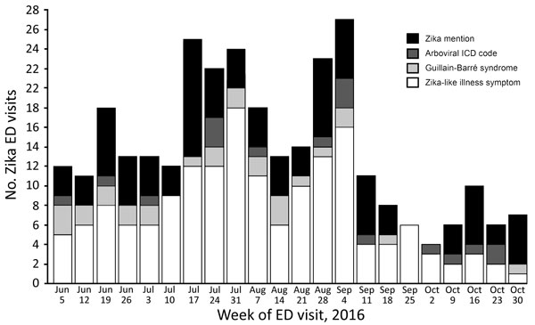
Figure
Figure. Number of ED visits for Zika-like illness in New York City, NY, USA, during June 1–October 31, 2016, by week and type of visit. ED, emergency department; ICD, International Classification of Diseases.
Wahnich A, Clark S, Bloch D, Kubinson H, Hrusa G, Liu D, et al. Surveillance for Mosquitoborne Transmission of Zika Virus, New York City, NY, USA, 2016. Emerg Infect Dis. 2018;24(5):827-834. https://doi.org/10.3201/eid2405.170764

