Slide 1
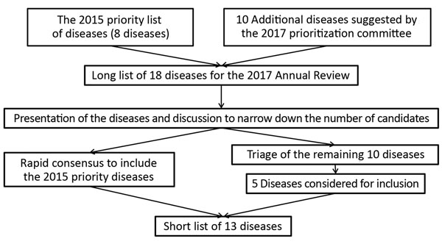
Figure 2
Figure 2. Process for compiling the short list of diseases for inclusion in the World Health Organization R&amp;D Blueprint to prioritize emerging infectious diseases in need of research and development.
Mehand M, Millett P, Al-Shorbaji F, Roth C, Kieny M, Murgue B. World Health Organization Methodology to Prioritize Emerging Infectious Diseases in Need of Research and Development. Emerg Infect Dis. 2018;24(9). https://doi.org/10.3201/eid2409.171427

