Slide 1
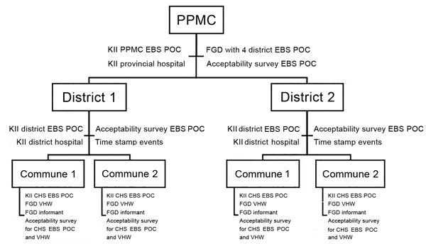
Figure 4
Figure 4. Assessment tools deployed at each site for assessment of an EBS pilot project, Vietnam, September 2016–May 2017. Acceptability survey and time stamp events tool were sent to all districts in the pilot provinces, not only to the sites selected for the FGD and KII site visits. CHS, commune health station; EBS, event-based surveillance; FGD, focus group discussion; FP, focal point; KII, key informant interview; POC, point of contact; PPMC, Provincial Preventive Medicine Center; VHW, village health worker.
Clara A, Do TT, Dao A, Tran PD, Dang TQ, Tran QD, et al. Event-Based Surveillance at Community and Healthcare Facilities, Vietnam, 2016–2017. Emerg Infect Dis. 2018;24(9):1649-1658. https://doi.org/10.3201/eid2409.171851

