Slide 1
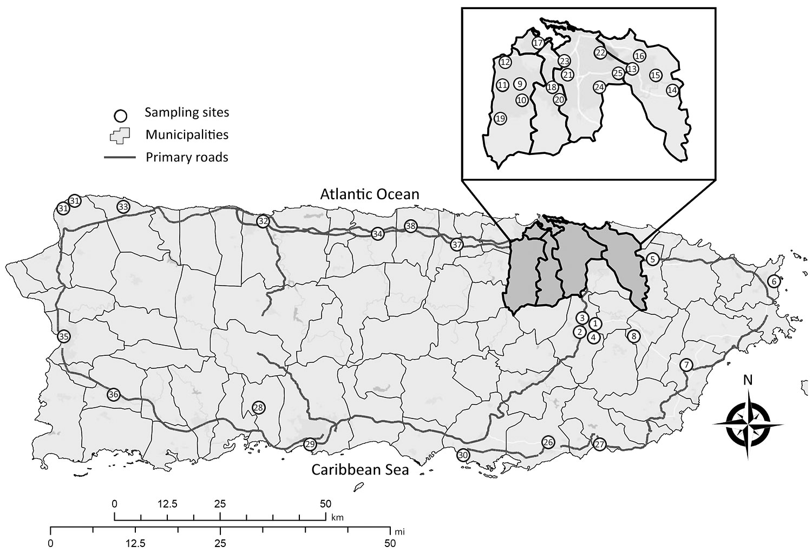
Figure
Figure. Locations of Aedes aegypti egg collections for insecticide resistance testing, Puerto Rico, 2016. Municipalities or barrios: 1, Caguas, Condado Moderno; 2, Caguas, Urb Idamaris Garden; 3, Caguas, Villa Blanca; 4, Caguas, Villa de Castro; 5, Canóvanas; 6, Fajardo; 7, Humacao; 8, Juncos; 9, Bayamón; 10, Bayamón, Irlanda; 11, Bayamón, Pájaros; 12, Bayamón, Teresita; 13, Carolina, El Comandante; 14, Carolina, Los Colobos; 15, Carolina, Villa Carolina; 16, Carolina, Vistamar; 17, Cataño; 18, Guaynabo, Ponce de León; 19, Guaynabo, Sabana; 20. Guaynabo, Villa Clementina; 21, San Juan, Caparra Terrace; 22, San Juan, Israel; 23, San Juan, Puerto Nuevo; 24, San Juan, Venus Garden; 25, San Juan, El Commandante; 26, Guayama; 27, Patillas; 28, Peñuelas; 29, Ponce; 30, Salinas; 31, Aquadilla; 32, Arecibo; 33, Isabela; 34, Manati; 35, Mayagüez; 36, San German; 37, Vega Alta; 38, Vega Baja. Inset shows closer view of dark gray shaded area.
Hemme RR, Vizcaino L, Harris AF, Felix G, Kavanaugh M, Kenney JL, et al. Rapid Screening of Aedes aegypti Mosquitoes for Susceptibility to Insecticides as Part of Zika Emergency Response, Puerto Rico. Emerg Infect Dis. 2019;25(10):1959-1961. https://doi.org/10.3201/eid2510.181847

