Slide 1
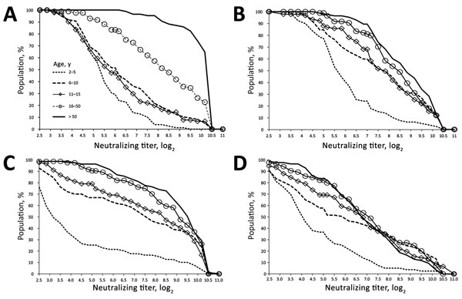
Figure 2
Figure 2. Reverse cumulative distribution curves of neutralizing antibody titers against enterovirus D68 isolates, by isolate and age group, Kansas City, Missouri, USA, 2012–2013. A) Fermon; B) dominant 2014 isolate 14-18949; C) less frequently circulating 2014 isolate 14-18952; D) rare 2014 isolate 14-18953. The reverse cumulative distribution pattern for 14-18949 varied the least by age group.
Harrison CJ, Weldon WC, Pahud BA, Jackson M, Oberste M, Selvarangan R. Neutralizing Antibody against Enterovirus D68 in Children and Adults before 2014 Outbreak, Kansas City, Missouri, USA. Emerg Infect Dis. 2019;25(3):585-588. https://doi.org/10.3201/eid2503.180960

