Slide 1
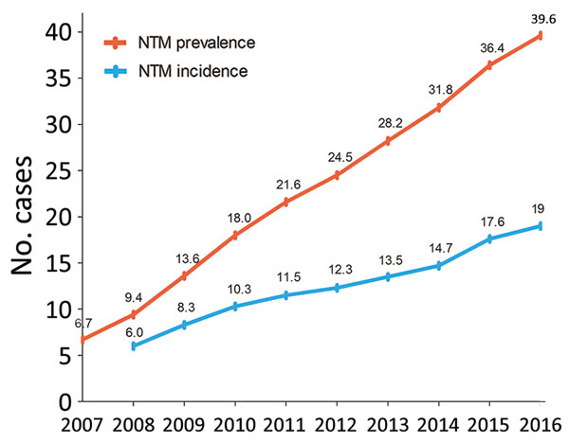
Figure 1
Figure 1. Annual prevalence (total no. cases/100,000 population) and incidence (no. new cases/100,000/year) of nontuberculous mycobacterial infection, adjusted for age and sex, South Korea, 2007–2016.
Lee H, Myung W, Koh W, Moon S, Jhun B. Epidemiology of Nontuberculous Mycobacterial Infection, South Korea, 2007–2016. Emerg Infect Dis. 2019;25(3):569-572. https://doi.org/10.3201/eid2503.181597

