Slide 1
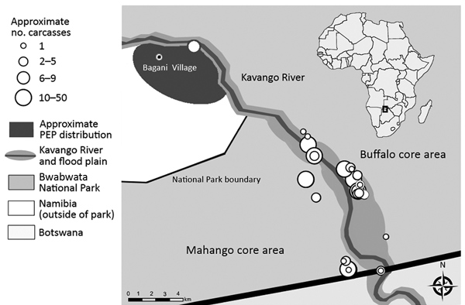
Figure 1
Figure 1. Anthrax investigation points of interest within and directly adjacent to Bwabwata National Park, Namibia, 2017. Inset shows location of park in Africa.
Cossaboom CM, Khaiseb S, Haufiku B, Katjiuanjo P, Kannyinga A, Mbai K, et al. Anthrax Epizootic in Wildlife, Bwabwata National Park, Namibia, 2017. Emerg Infect Dis. 2019;25(5):947-950. https://doi.org/10.3201/eid2505.180867

