Slide 1
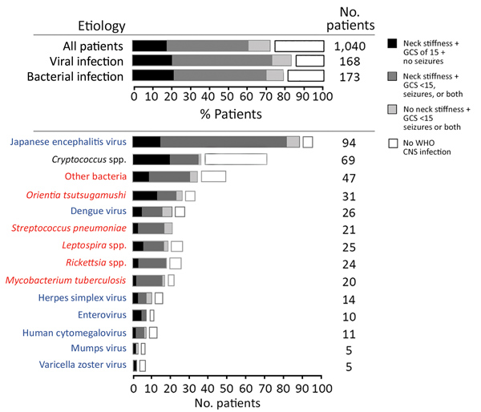
Figure 4
Figure 4. Distribution of clinical presentations in patients with suspected central nervous system infection, by confirmed etiology, Laos, January 2003–August 2011. Analysis per pathogen includes only patients with monoinfections. Other bacteria include 7 Escherichia coli, 4 Streptococcus agalactiae, 4 Neisseria meningitidis, 1 Salmonella enterica group D, 1 S. enterica group B or C, 5 S. enterica serovar typhi, 4 Streptococcus suis, 3 Klebsiella pneumoniae, 7 Haemophilus influenzae type b, 5 Burkholderia pseudomallei, 6 Staphylococcus aureus, and 1 Morganella morganii. Blue font indicates viruses, red font indicates bacteria, and black font indicates fungi. CNS, central nervous system; GCS, Glasgow Coma Scale; WHO, World Health Organization.
Dubot-Pérès A, Mayxay M, Phetsouvanh R, Lee SJ, Rattanavong S, Vongsouvath M, et al. Management of Central Nervous System Infections, Vientiane, Laos, 2003–2011. Emerg Infect Dis. 2019;25(5):898-910. https://doi.org/10.3201/eid2505.180914

