Slide 1
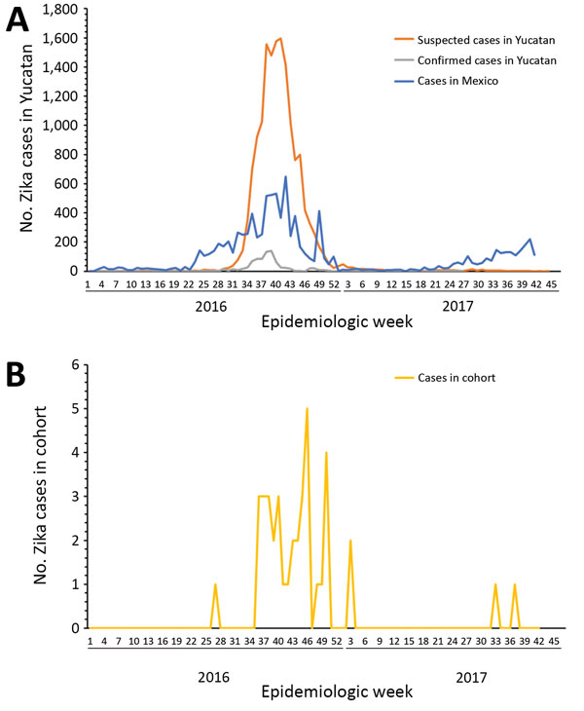
Figure
Figure. Distribution of cases of Zika virus infection, by epidemiologic week, Mexico, 2016–2017. A) Suspected and confirmed cases of Zika virus infection in Yucatan State and cases in Mexico. B) Cases of Zika virus infection among 115 pregnant women enrolled in study in 3 areas of Yucatan State.
Romer Y, Valadez-Gonzalez N, Contreras-Capetillo S, Manrique-Saide P, Vazquez-Prokopec G, Pavia-Ruz N. Zika Virus Infection in Pregnant Women, Yucatan, Mexico. Emerg Infect Dis. 2019;25(8):1452-1460. https://doi.org/10.3201/eid2508.180915

