Slide 1
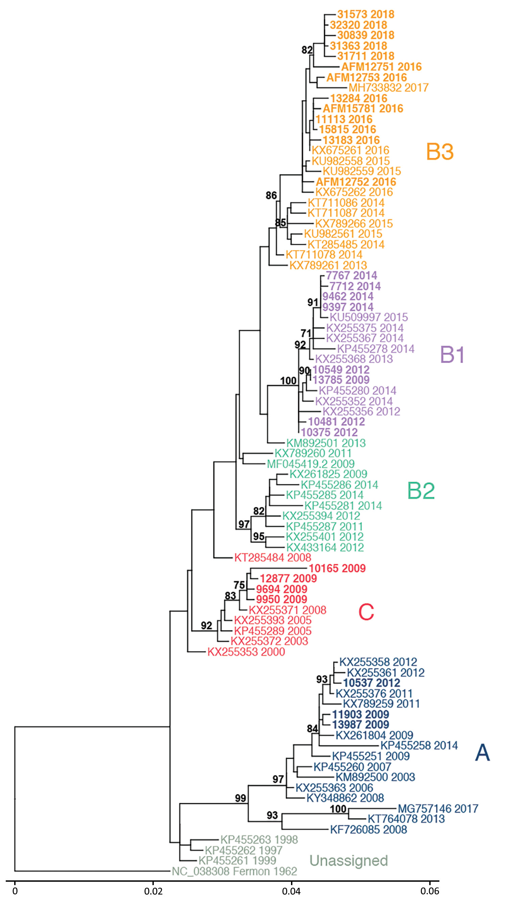
Figure 2
Figure 2. Phylogenetic relationships between Philadelphia whole enterovirus D68 (EV-D68) genomes, including AFM cases, Philadelphia, Pennsylvania, USA, 2009–2018. EV-D68 polyprotein sequences from GenBank (n = 55) and this study (n = 28) were used to build a maximum-likelihood tree. EV-D68 clades, defined in prior publications, are indicated. Sequences from this study are indicated in bold, and AFM cases are indicated with that prefix. AFM, acute flaccid myelitis. Scale bar indicates nucleotide substitutions per site.
Uprety P, Curtis D, Elkan M, Fink J, Rajagopalan R, Zhao C, et al. Association of Enterovirus D68 with Acute Flaccid Myelitis, Philadelphia, Pennsylvania, USA, 2009–2018. Emerg Infect Dis. 2019;25(9):1676-1682. https://doi.org/10.3201/eid2509.190468

