Slide 1
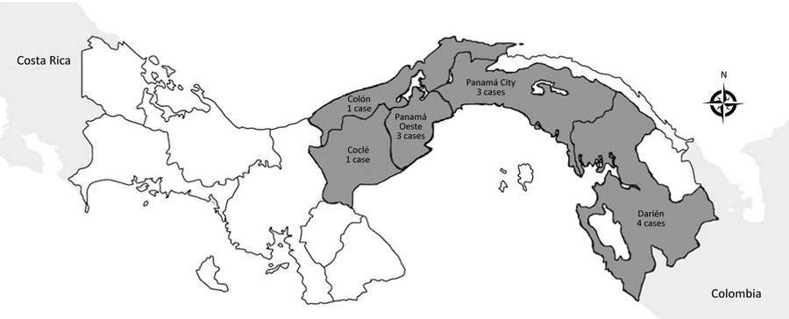
Figure
Figure. Regional distribution of melioidosis cases in Panama, 2007–2017.
Araúz AB, Castillo K, Santiago E, Quintero Y, Adames E, Castillo B, et al. Geographic Distribution and Incidence of Melioidosis, Panama. Emerg Infect Dis. 2020;26(1):118-121. https://doi.org/10.3201/eid2601.180870

