Slide 1
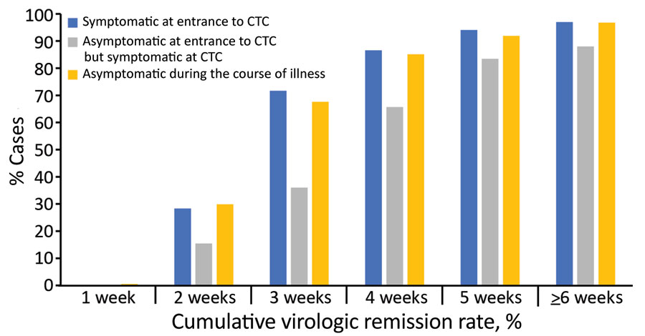
Figure 1
Figure 1. Cumulative virologic remission rate for coronavirus disease in patients in South Korea who were symptomatic at the time of entrance to a community treatment center (CTC), asymptomatic at the time of entrance to the CTC but developed symptoms during CTC admission, and asymptomatic during the course of illness after diagnosis. Cumulative remission rates of each group were calculated according to the time from diagnosis to virologic remission.
Lee Y, Hong C, Kim D, Lee T, Lee J. Clinical Course of Asymptomatic and Mildly Symptomatic Patients with Coronavirus Disease Admitted to Community Treatment Centers, South Korea. Emerg Infect Dis. 2020;26(10):2346-2352. https://doi.org/10.3201/eid2610.201620

