Slide 1
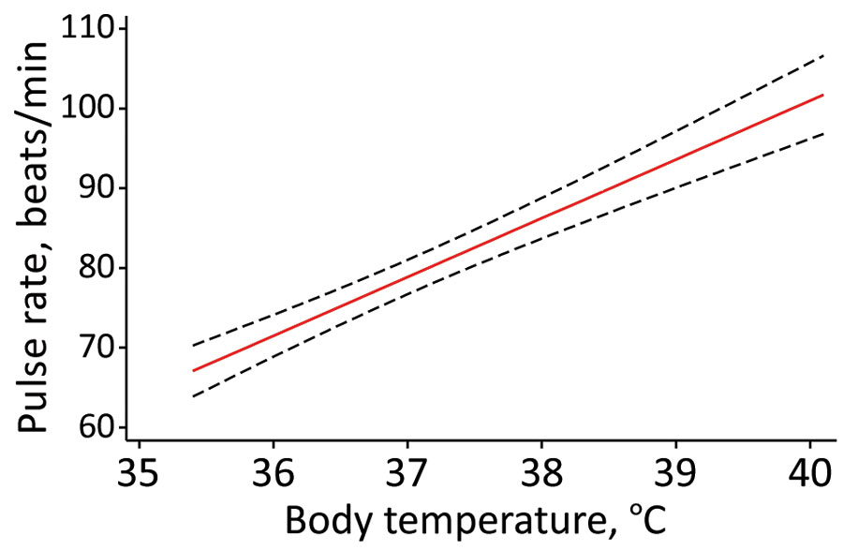
Figure
Figure. Predicted pulse rate over body temperature (red line) based on final random intercept model for relative bradycardia in patients with mild-to-moderate coronavirus disease, Japan. Black dashed lines indicate 95% CIs.
Ikeuchi K, Saito M, Yamamoto S, Nagai H, Adachi E. Relative Bradycardia in Patients with Mild-to-Moderate Coronavirus Disease, Japan. Emerg Infect Dis. 2020;26(10):2504-2506. https://doi.org/10.3201/eid2610.202648

