Slide 1
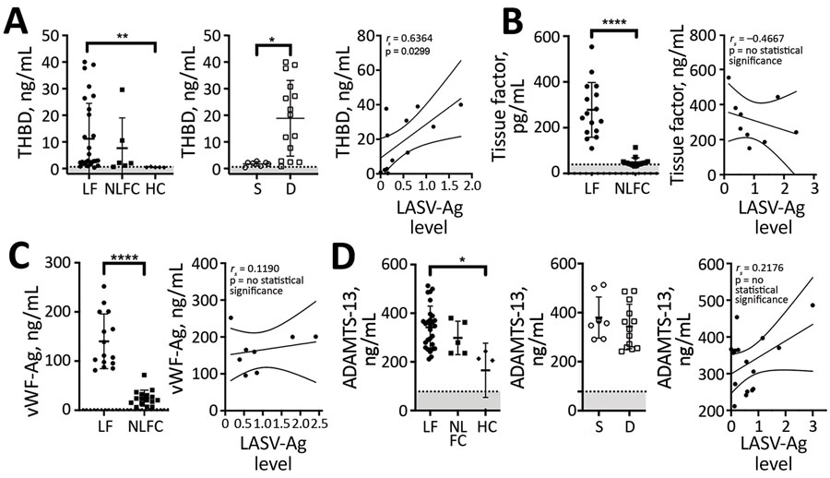
Figure 2
Figure 2. Laboratory findings for coagulation markers for patients with acute LF, NLFCs, and HCs, Sierra Leone, 2015–2018. A) Soluble thrombomodulin is elevated in LF and predicts fatal outcomes (Kruskal-Wallis p = 0.0002 across all groups). Levels of soluble THBD were statistically significantly higher (**p = 0.0084) in acute LF cases (n = 28) than in HCs (n = 5); patients who died (n = 15) had higher levels of soluble THBD than those who survived (n = 7; *p = 0.0239); and we noted a positive correlation between soluble THBD and LASV-Ag levels (n = 12). B) Tissue factor was statistically significantly elevated (****p&lt;0.0001) in acute fatal LF cases (n = 16) compared with NLFC (n = 16), but no statistically significant correlation was found between TF and LASV-Ag levels in LF patients. C) vWF Ag levels were statistically significantly elevated (****p&lt;0.0001) in acute fatal LF patients (n = 15) compared with NLFC (n = 16), but no statistically significant correlation was found between vWF and LASV-Ag levels in LF patients. D) Plasma levels of ADAMTS-13 were statistically significantly different between groups (Kruskal-Wallis p = 0.0155). Levels of ADAMTS-13 were statistically significantly higher (*p = 0.0292) in patients with acute LF (n = 28) compared with HCs (n = 4). No differences were seen between those who died (n = 13) versus those who survived (n = 8), nor was a statistically significant correlation found between ADAMTS-13 and LASV-Ag in LF patients. Limits of detection are indicated by dashed lines and gray shading below. Error bars show SDs; horizontal lines indicate means. D, died; HC, healthy control; LF, Lassa fever; LASV-Ag, Lassa fever virus antigen; NLFC, non-LF febrile control; S, survived; THBD, thrombomodulin; vWF, von Willebrand factor; vWF-Ag, von Willebrand factor antigen.
Horton LE, Cross RW, Hartnett JN, Engel EJ, Sakabe S, Goba A, et al. Endotheliopathy and Platelet Dysfunction as Hallmarks of Fatal Lassa Fever. Emerg Infect Dis. 2020;26(11):2625-2637. https://doi.org/10.3201/eid2611.191694

