Slide 1
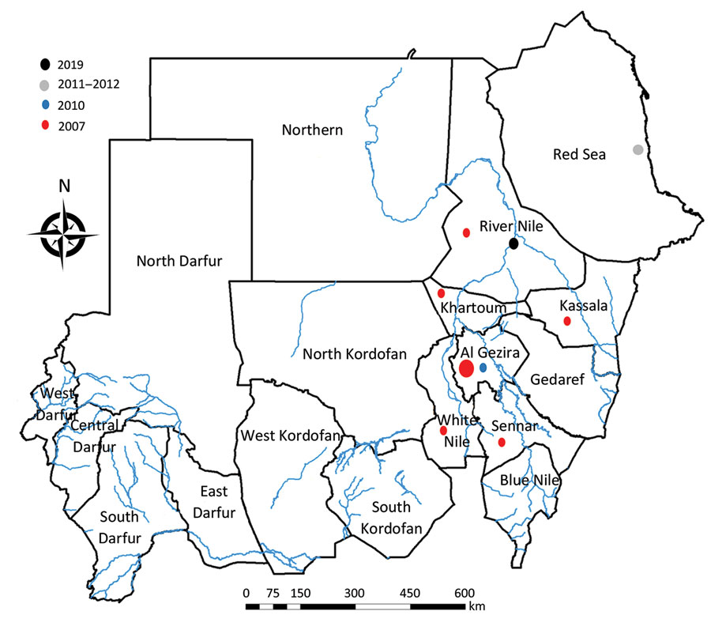
Figure 1
Figure 1. Distribution of Rift Valley fever outbreaks in Sudan, by year.
Ahmed A, Ali Y, Elduma A, Eldigail M, Mhmoud R, Mohamed N, et al. Unique Outbreak of Rift Valley Fever in Sudan, 2019. Emerg Infect Dis. 2020;26(12):3030-3033. https://doi.org/10.3201/eid2612.201599

