Slide 1
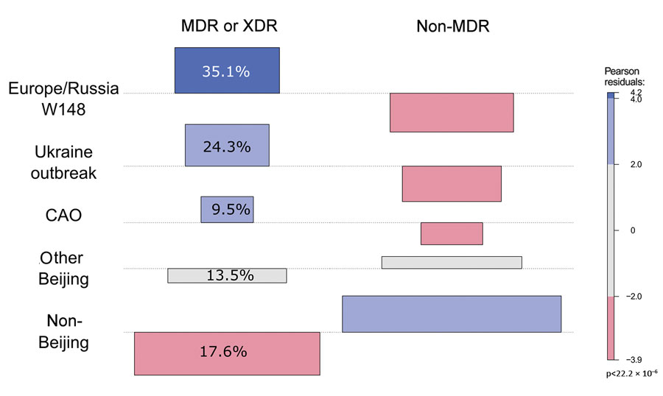
Figure 3
Figure 3. Association plot comparing expected and observed numbers of MDR/XDR and non-MDR strains from different phylogenetic groups. The colors and bar heights reflect the Pearson residuals, the width of the boxes is proportional to the square root of the expected cell counts, blue squares reflect values that are overrepresented, and red squares reflect values that are underrepresented. Pearson values of +2 represent significant deviation at α = 0.05 level, and values of +4 represent significant deviation at α = 0.001 level. For example, there are more MDR/XDR TB strains in the Europe/Russia W148 clade (35.1% of all MDR/XDR strains) than expected under the hypothesis of independence. CAO, Central Asian outbreak; MDR, multidrug resistant; XDR, extensively drug-resistant.
Merker M, Nikolaevskaya E, Kohl TA, Molina-Moya B, Pavlovska O, Brännberg P, et al. Multidrug- and Extensively Drug-Resistant Mycobacterium tuberculosis Beijing Clades, Ukraine, 2015. Emerg Infect Dis. 2020;26(3):481-490. https://doi.org/10.3201/eid2603.190525

