Slide 1
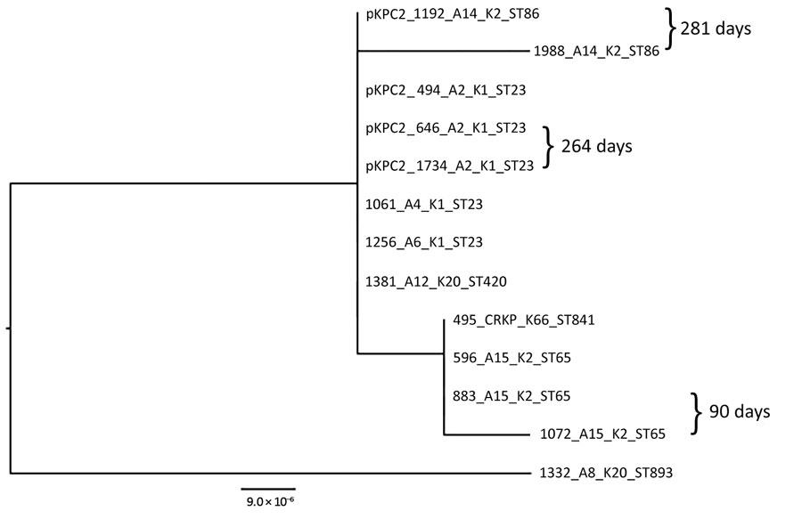
Figure 4
Figure 4. Maximum-likelihood analysis of pKPC2 plasmids from carbapenem-resistant hypervirulent Klebsiella pneumoniae isolates, Singapore, 2013–2015. pKPC2_494 was used as reference. Labels indicate isolate no._patient no._K serotype_sequence type. Days between isolate collection are indicated. Scale bar indicates nucleotide changes per base pair. KPC, Klebsiella pneumoniae carbapenemase; ST, sequence type.
Chen Y, Marimuthu K, Teo J, Venkatachalam I, Cherng B, De Wang L, et al. Acquisition of Plasmid with Carbapenem-Resistance Gene blaKPC2 in Hypervirulent Klebsiella pneumoniae, Singapore. Emerg Infect Dis. 2020;26(3):549-559. https://doi.org/10.3201/eid2603.191230

