Slide 1
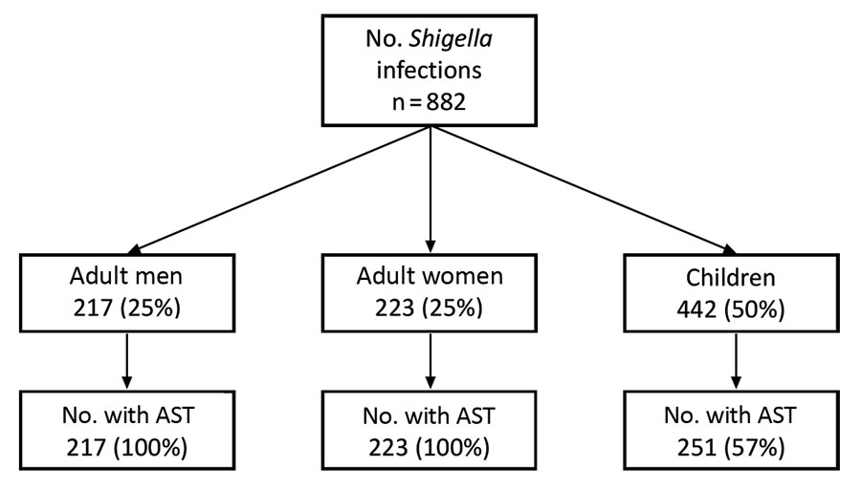
Figure 1
Figure 1. Number of Shigella isolates for which AST was conducted, by demographic group among isolates received at the Minnesota Department of Health, 2012–2015. AST, antimicrobial susceptibility testing.
Eikmeier D, Talley P, Bowen A, Leano F, Dobbins G, Jawahir S, et al. Decreased Susceptibility to Azithromycin in Clinical Shigella Isolates Associated with HIV and Sexually Transmitted Bacterial Diseases, Minnesota, USA, 2012–2015. Emerg Infect Dis. 2020;26(4):667-674. https://doi.org/10.3201/eid2604.191031

