Slide 1
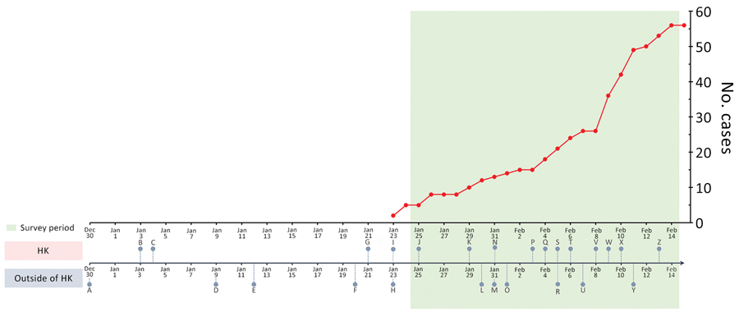
Figure 1
Figure 1. Chronology of major events during the early phase of the coronavirus disease epidemic and laboratory-confirmed cases in Hong Kong, December 30, 2019–February 14, 2020. A, unexplained pneumonia reported in Wuhan, China; B, HK begins temperature screenings at border checkpoints for travelers from Wuhan; C, HK launches preparedness and response plan for novel infectious disease of public health significance, serious response level; D, first death reported in Wuhan; E, World Health Organization (WHO) names disease 2019-nCoV acute respiratory disease and the virus 2019-nCoV (refer to Y for subsequent renaming); F, China confirms human-to-human transmission; G, HK introduces health declaration form system on inbound travelers by air from Wuhan; H, WHO declines to declare COVID-19 a public health emergency of international concern; I, first first confirmed COVID-19 case in HK, halt of sale of high-speed rail tickets to and from Wuhan; J, HK activates emergency response level; K, HK closes public leisure and cultural facilities until further notice; L, WHO declares COVID-19 a public health emergency of international concern; M, United States declares COVID-19 a public health emergency, imposes entry restriction; N, HK imposes 4-week school suspension, 1-week extension for home-office arrangement for civil servants; O, first COVID-19 death outside China in the Philippines; P, HK medical workers strike to call for border shutdown; Q, first COVID-19 death in HK, closure of 4 more border control points; R, 46 foreign airlines cancelled flights to mainland China; S, HK implements further port hygiene measures; T, HK offers home-office arrangement for civil servants until February 16; U, first death of a doctor in China (Wuhan); V, HK begins mandatory 14-day quarantine on persons entering from China; W, HK reports COVID-19 cluster involving 9 people in a gathering on January 26; X, HK reports COVID-19 cluster involving 5 residents (2 families) in the same building; Y, WHO and ICTV rename disease COVID-19 and virus SARS-CoV-2; Z, HK extends home-office arrangement for civil servants until February 23, school suspension until March 16. HK, Hong Kong.
Kwok K, Li K, Chan H, Yi Y, Tang A, Wei W, et al. Community Responses during Early Phase of COVID-19 Epidemic, Hong Kong. Emerg Infect Dis. 2020;26(7):1575-1579. https://doi.org/10.3201/eid2607.200500

