Slide 1
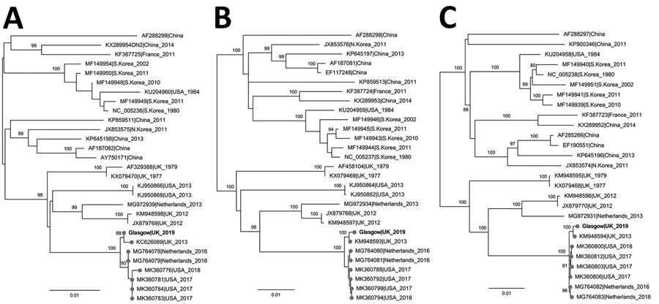
Figure
Figure. Maximum-likelihood phylogenetic tree based on the small (A), medium (B), and large (C) segments of Seoul virus isolated from a patient in Scotland, United Kingdom, 2020 (bold text; GenBank accession nos. MZ343375–7), and reference sequences. Isolate names indicate GenBank accession number as well as location and date of isolate. Phylogenetic relationships inferred by RAxML (https://github.com/stamatak/standard-RAxML) using the general time-reversible plus gamma distribution plus invariable site model as determined by jModeltest (https://github.com/ddarriba/jmodeltest2). The tree was rooted at midpoint. Numbers to the left of nodes indicate bootstrap values based on 1,000 replicates. Gray circles indicate sequences associated with domesticated rats. Scale bar indicates substitutions per site.
Shepherd JG, Blunsum AE, Carmichael S, Smollett K, Maxwell-Scott H, Farmer E, et al. Seoul Virus Associated with Pet Rats, Scotland, UK, 2019. Emerg Infect Dis. 2021;27(10):2677-2680. https://doi.org/10.3201/eid2710.211298

