Slide 1
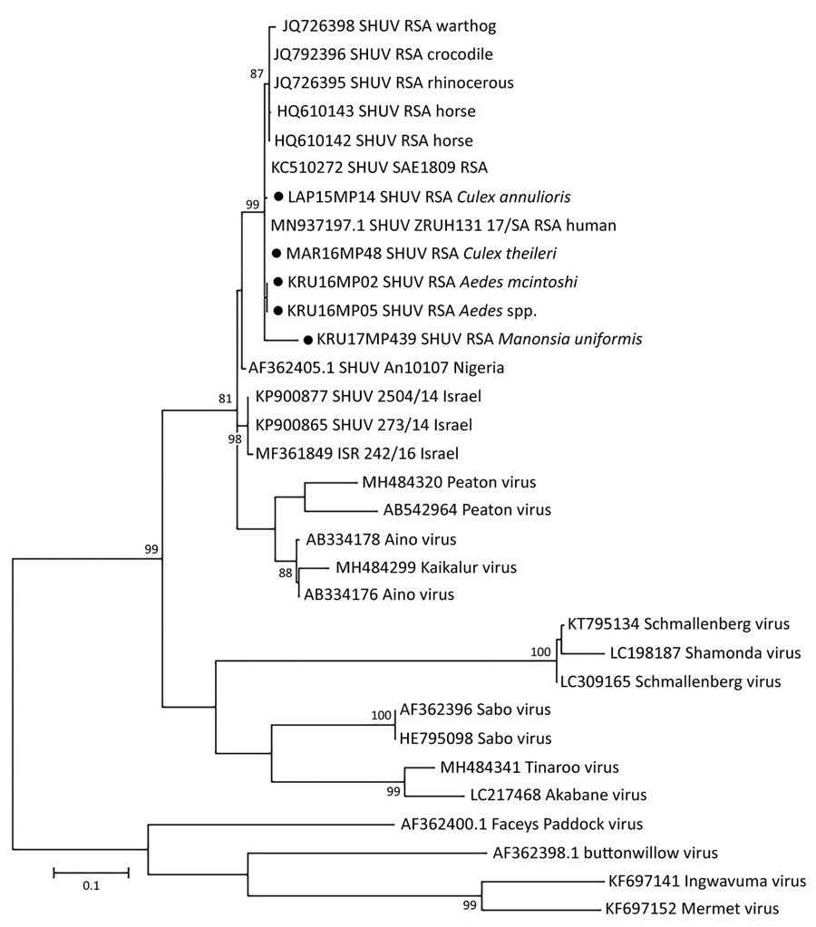
Figure 2
Figure 2. Phylogenetic tree of SHUV-positive homogenate mosquito pools, South Africa, January 2014–May 2018 (black dots), based on 32 sequences and 328 bp of the nucleocapsid gene on the small segment. The tree was constructed with MEGA 7 software (https://www.megasoftware.net) by using the maximum-likelihood method and the Kimura 2-parameter model with 1,000 bootstrap replicates and includes members of the Simbu serogroup. The tree with the highest log likelihood (−299.13) is shown. GenBank accession numbers are indicated for the new and reference strains, which were selected from SHUV strains identified in South Africa among horses and wildlife (4,9) as well as strains from Nigeria and Israel available in GenBank. Numbers on internal branches indicate bootstrap values. RSA, South Africa; SHUV, Shuni virus.
Guarido M, Motlou T, Riddin MA, MacIntyre C, Manyana S, Johnson T, et al. Potential Mosquito Vectors for Shuni Virus, South Africa, 2014–2018. Emerg Infect Dis. 2021;27(12):3142-3146. https://doi.org/10.3201/eid2712.203426

