Slide 1
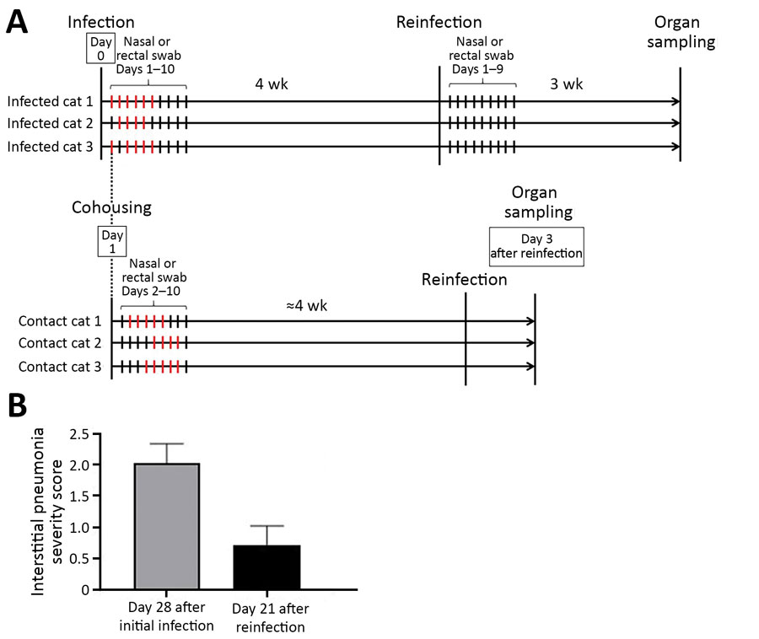
Figure 2
Figure 2. Timeline of severe acute respiratory syndrome coronavirus 2 infection and reinfection of cats and distribution of interstitial thickening. A) Timeline of infection and reinfection. As reported previously (1), a group of cats was inoculated with severe acute respiratory syndrome coronavirus 2 on day 0 (infected cats 1–3, upper half). A virus-naive cat was cohoused with each of the infected cats from day 1 (contact cats 1–3, lower half). The days on which infectious virus was detected in the nasal swabs are shown as red bars for each animal. In this study, we infected the cats with the same severe acute respiratory syndrome coronavirus 2 isolate at ≈4 weeks after initial infection or exposure to infected cats. After reinfection of the group shown in the upper half of the figure, no infectious virus was detected in the nasal swabs. The cats were confirmed to be seronegative before the initial infection or cohousing with infected cats, and seropositive before reinfection, on the basis of neutralization assay results. B) The distribution of interstitial thickening (interstitial pneumonia severity score) was decreased on day 21 after reinfection compared with day 28 (p = 0.041 by unpaired t-test).
Chiba S, Halfmann PJ, Hatta M, Maemura T, Fan S, Armbrust T, et al. Protective Immunity and Persistent Lung Sequelae in Domestic Cats after SARS-CoV-2 Infection. Emerg Infect Dis. 2021;27(2):660-663. https://doi.org/10.3201/eid2702.203884

