Slide 1
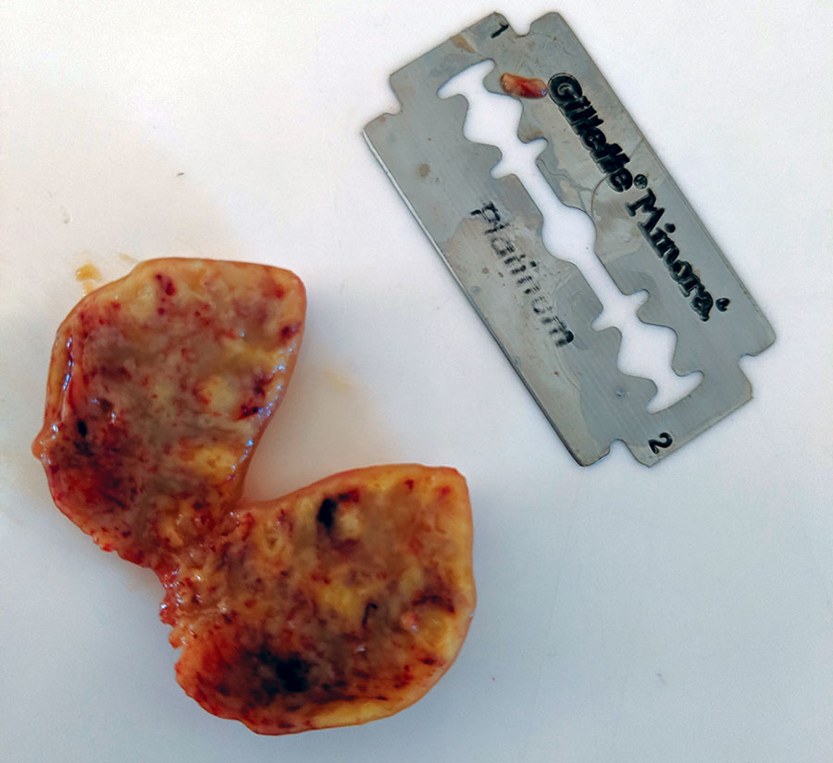
Figure
Figure. Lymph node removed from ring-tailed lemur in Madagascar that exhibited advanced clinical symptoms consistent with tuberculosis. Blade is 44 mm by 22 mm.
LaFleur M, Reuter KE, Hall MB, Rasoanaivo HH, McKernan S, Ranaivomanana P, et al. Drug-Resistant Tuberculosis in Pet Ring-Tailed Lemur, Madagascar. Emerg Infect Dis. 2021;27(3):977-979. https://doi.org/10.3201/eid2703.202924

