Slide 1
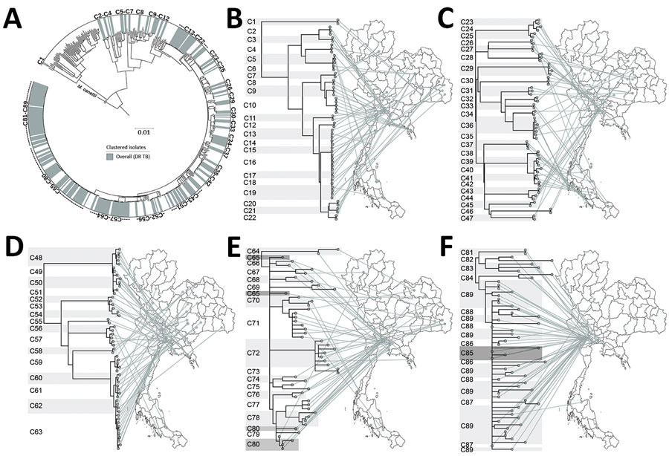
Figure 4
Figure 4. All clusters of DR TB isolates from Thailand. A) A total of 89 clusters are highlighted in the outer circle. Scale bar indicates the genetic distance proportional to the total number of single nucleotide polymorphisms. B–F) Phylogeographical links of each cluster are shown. For clarity, clusters are divided among 5 phylomaps. Some isolates in closely related clusters (C64–C65, C79–C80, and C85–C89) crossed localities. Mycobacterium canetti was used as an outgroup. DR TB, drug-resistant tuberculosis.
Nonghanphithak D, Chaiprasert A, Smithtikarn S, Kamolwat P, Pungrassami P, Chongsuvivatwong V, et al. Clusters of Drug-Resistant Mycobacterium tuberculosis Detected by Whole-Genome Sequence Analysis of Nationwide Sample, Thailand, 2014–2017. Emerg Infect Dis. 2021;27(3):813-822. https://doi.org/10.3201/eid2703.204364

