Slide 1
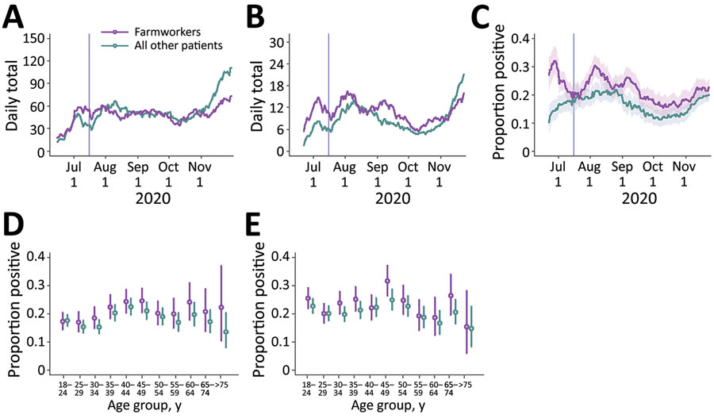
Figure 1
Figure 1. Cases of severe acute respiratory syndrome coronavirus 2 (SARS-CoV-2) diagnosed at Clínica de Salud del Valle de Salinas (CSVS), Monterey County, California, USA, June 15–November 30, 2020. We plotted the 2-week moving averages of the number of patients tested by CSVS (A); the number of SARS-CoV-2 infections diagnosed (B); and the proportion of tests yielding positive results (C). Shading indicates 95% CIs. Vertical lines indicate the date the cross-sectional study began, July 16. We also plotted age- and sex- stratified test-positive fractions for female (D) and male (E) patients. Bars indicate ranges; circles indicate medians.
Lewnard JA, Mora AM, Nkwocha O, Kogut K, Rauch SA, Morga N, et al. Prevalence and Clinical Profile of Severe Acute Respiratory Syndrome Coronavirus 2 Infection among Farmworkers, California, USA, June–November 2020. Emerg Infect Dis. 2021;27(5):1330-1342. https://doi.org/10.3201/eid2705.204949

