Slide 1
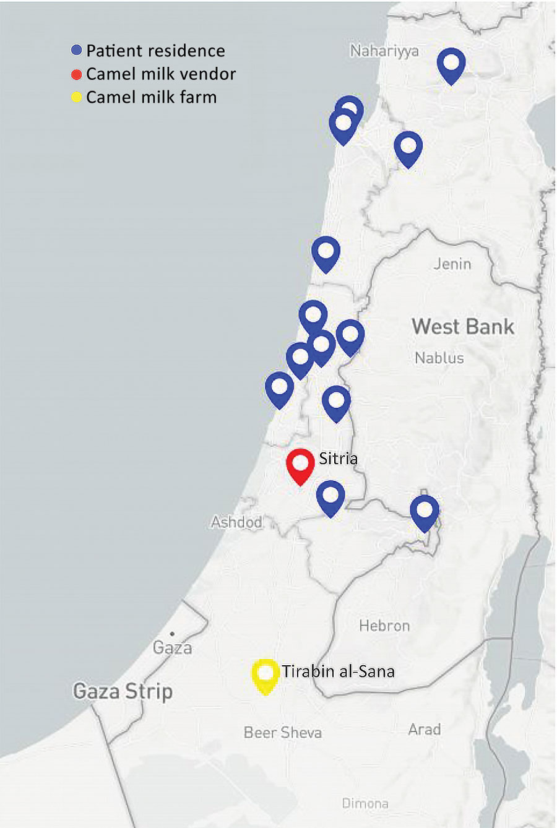
Figure 1
Figure 1. Geographic distribution of cases of Brucella melitensis traced to consumption of commercialized camel milk in Israel, 2016. Shown are the location of the camel farm in southern Israel from which raw milk was obtained), the vendor in central Israel that distributed the milk through direct online sales or other retail stores, and the places of residence of individual case-patients linked to the outbreak.
Bardenstein S, Gibbs RE, Yagel Y, Motro Y, Moran-Gilad J. Brucellosis Outbreak Traced to Commercially Sold Camel Milk through Whole-Genome Sequencing, Israel. Emerg Infect Dis. 2021;27(6):1728-1731. https://doi.org/10.3201/eid2706.204902

