Slide 1
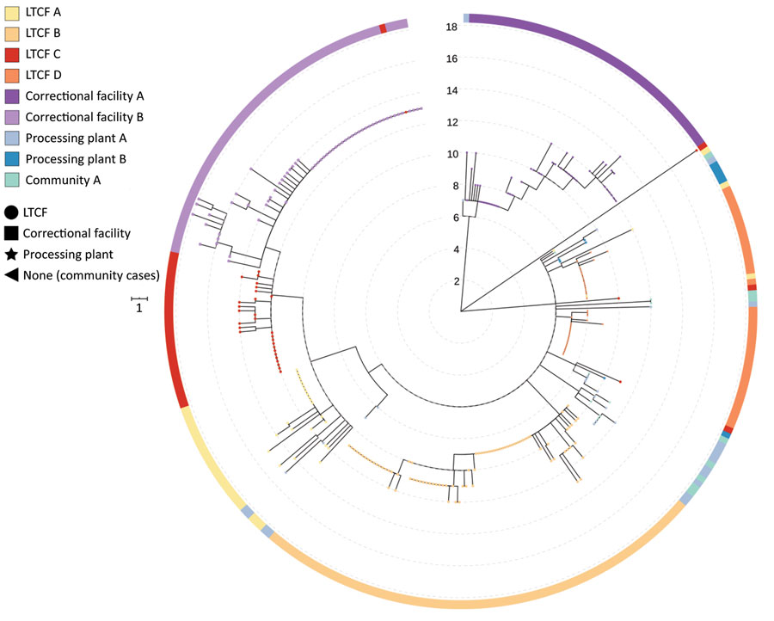
Figure 1
Figure 1. Phylogenetic tree of severe acute respiratory syndrome coronavirus 2 associated with selected outbreaks in Minnesota, USA, March 6–June 30, 2020. IQ-TREE (29) was used with the general time reversible substitution model for tree generation. Branch lengths were scaled to represent number of single-nucleotide mutations as shown in the scale key. LTCF, long-term care facility.
Lehnertz NB, Wang X, Garfin J, Taylor J, Zipprich J, VonBank B, et al. Transmission Dynamics of Severe Acute Respiratory Syndrome Coronavirus 2 in High-Density Settings, Minnesota, USA, March–June 2020. Emerg Infect Dis. 2021;27(8):2052-2063. https://doi.org/10.3201/eid2708.204838

