Slide 1
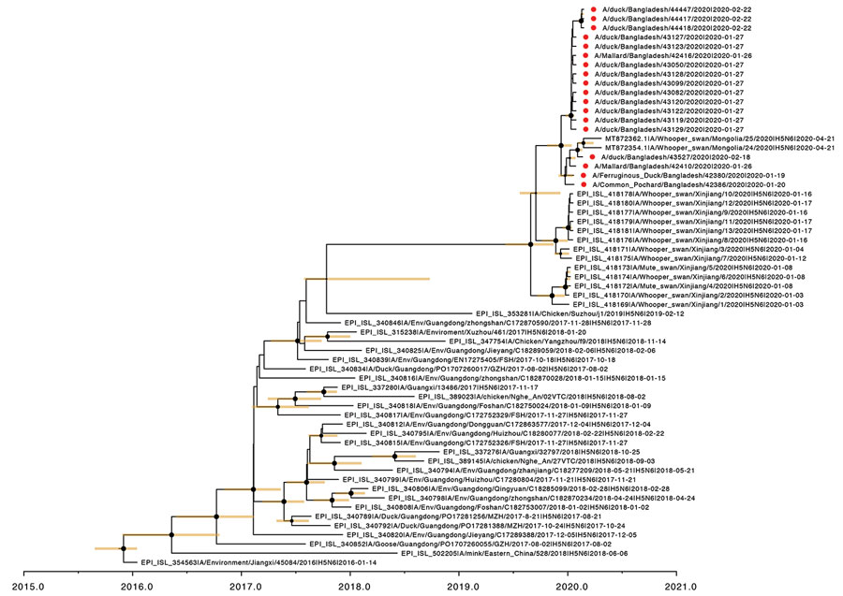
Figure 2
Figure 2. Time to the most recent common ancestor of Bangladesh H5N6 viruses; maximum clade credibility temporal phylogeny of the hemagglutinin (HA) gene. The H5N6 viruses from Bangladesh are represented by red dots. Posterior clade probabilities are indicated by the sizes of the internal node circles. Shaded bars represent the 95% highest probability distribution for the age of each node with posterior clade probability &gt;0.3.
Turner J, Barman S, Feeroz MM, Hasan M, Akhtar S, Jeevan T, et al. Highly Pathogenic Avian Influenza A(H5N6) Virus Clade 2.3.4.4h in Wild Birds and Live Poultry Markets, Bangladesh. Emerg Infect Dis. 2021;27(9):2492-2494. https://doi.org/10.3201/eid2709.210819

