Slide 1
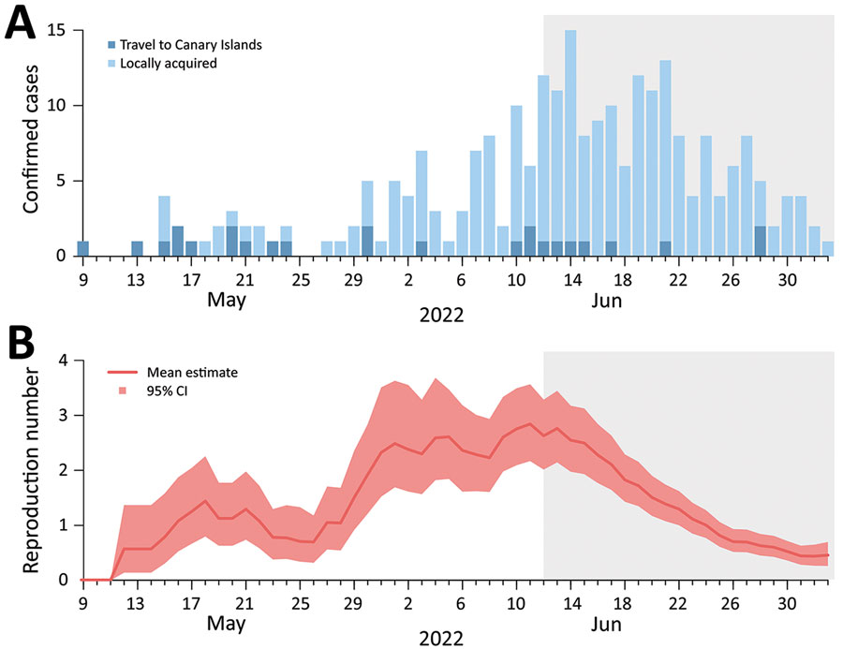
Figure
Figure. Epidemic curve and reproduction number of monkeypox cases in Italy through July 8, 2022. A) Number of cases by date of symptom onset and history of travel in Canary Islands. For 4 persons, the date of symptom onset was unknown. B) Estimate of the net reproduction number over time from the epidemic curve by date of symptom onset. We assumed that all cases with a history of travel to Canary Islands were imported and that all the others were locally transmitted, and we used a generation time distribution with mean 12.5 days. Gray shading indicates the part of the epidemic curve that is possibly incomplete because of diagnostic and reporting delays.
Guzzetta G, Mammone A, Ferraro F, Caraglia A, Rapiti A, Marziano V, et al. Early Estimates of Monkeypox Incubation Period, Generation Time, and Reproduction Number, Italy, May–June 2022. Emerg Infect Dis. 2022;28(10):2078-2081. https://doi.org/10.3201/eid2810.221126

