Slide 1
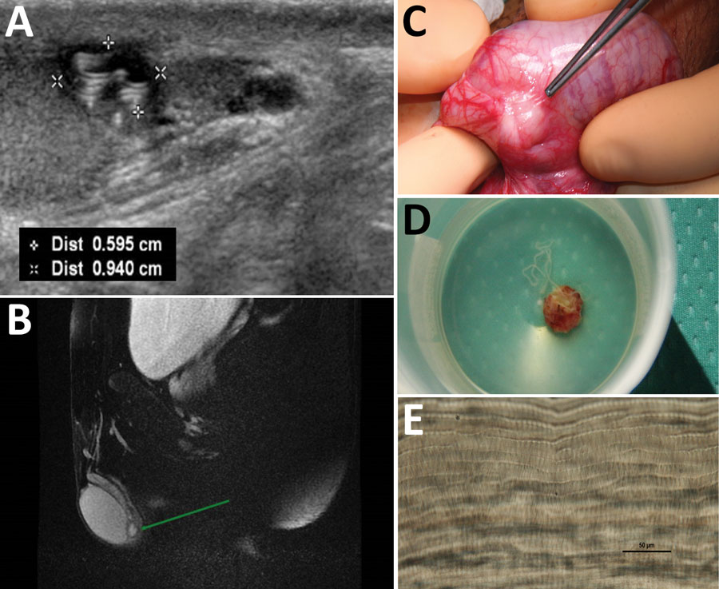
Figure
Figure. Diagnostic evaluation of Dirofilaria repens testicular infection in a child from Italy, a boy 13 years of age who had a 5-month history of swelling in the left testicle. A) Ultrasound scan showed a 0.5 × 0.9 cm hypoechoic cyst with moving artifacts and thread-like hyperechoic structures. B) Magnetic resonance imaging showed the cyst was located on the testis without signs of infiltration and contained fluid mixed with tubular structures and moving artifacts. C) Exploration of the scrotum before cyst excision showed a well-circumscribed, encapsulated tense nodule on the left side. D) The cyst was excised and a coiled roundworm was found in the opened capsule. E) We identified the nematode as a female D. repens nematode by microscopically observing typical longitudinal ridges on the body surface. Scale bar indicates 50 μm. Dist, distance.
Ugolini S, Lima M, Maffi M, Pierangeli F, Vastano M, Gargano T, et al. Dirofilaria repens Testicular Infection in Child, Italy. Emerg Infect Dis. 2022;28(12):2569-2572. https://doi.org/10.3201/eid2812.220424

