Slide 1
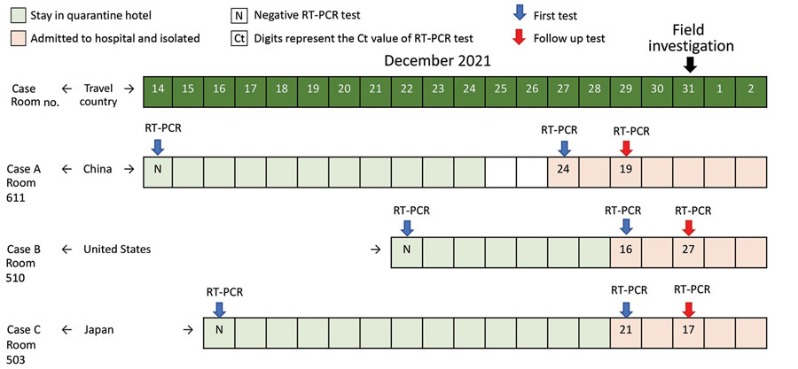
Figure 1
Figure 1. Timeline for Case A, Case B, and Case C in our investigation of aerosol transmission of the SARS-CoV-2 Omicron variant between separate, nonadjacent rooms in a quarantine hotel in Taipei City, Taiwan. Blue arrows indicate the results of the first RT-PCR testing, and red arrows indicate the results of the follow-up RT-PCR testing. The field investigation began on December 31, 2021.
Wei H, Chang C, Liu M, Mu J, Lin Y, Dai Y, et al. Probable Aerosol Transmission of SARS-CoV-2 through Floors and Walls of Quarantine Hotel, Taiwan, 2021. Emerg Infect Dis. 2022;28(12):2374-2382. https://doi.org/10.3201/eid2812.220666

