Slide 1
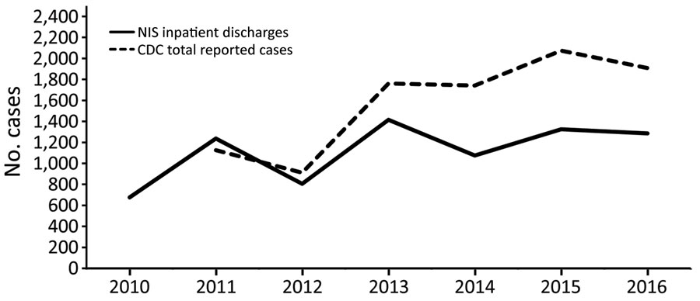
Figure
Figure. Cases of babesiosis in the United States, 2010–2016, CDC versus NIS data. CDC, Centers for Disease Control and Prevention; NIS, National Inpatient Sample.
Bloch EM, Day JR, Krause PJ, Kjemtrup A, O’Brien SF, Tobian A, et al. Epidemiology of Hospitalized Patients with Babesiosis, United States, 2010–2016. Emerg Infect Dis. 2022;28(2):354-362. https://doi.org/10.3201/eid2802.210213

