Slide 1
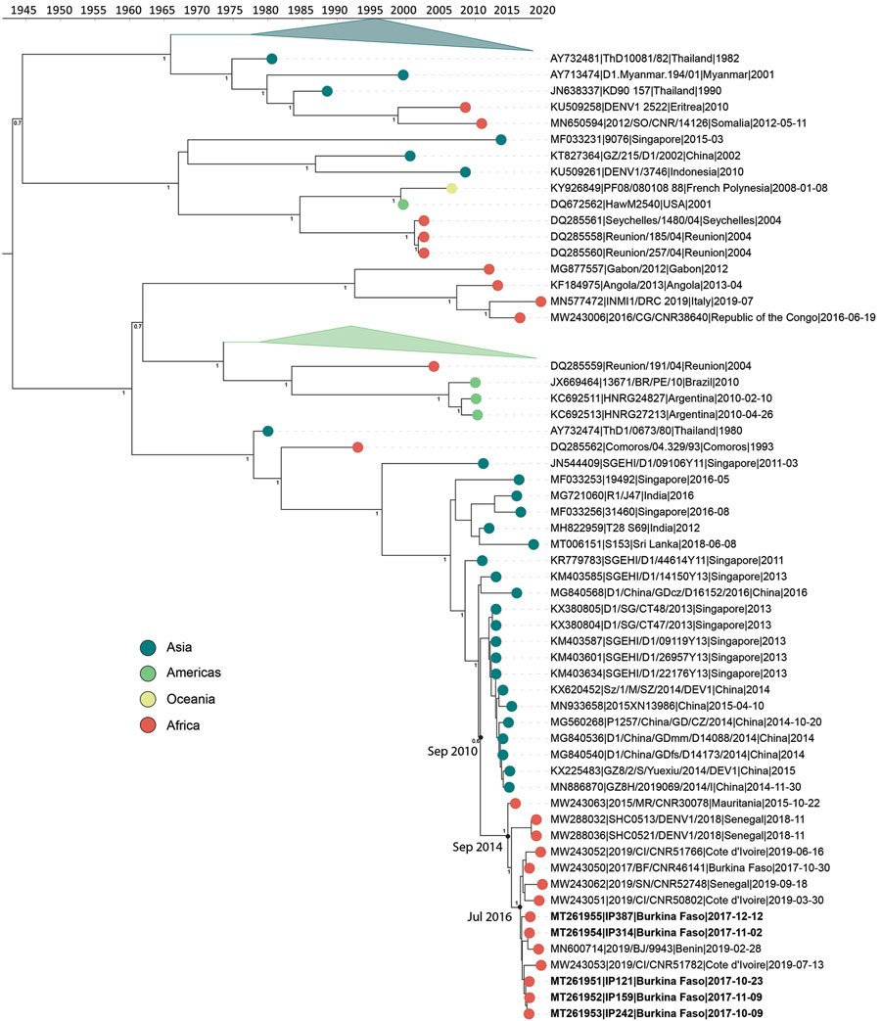
Figure 2
Figure 2. Time-calibrated phylogenetic trees of a subset of global dengue virus 1 genomes and 2017 Burkina Faso dengue virus outbreak genomes (boldface). Colored circles indicate geographic origin. Dates indicate the most recent common ancestor for the 2017 Burkina Faso dengue virus outbreak and all genomes from Africa. Posterior probabilities are indicated at major nodes. GenBank accession numbers are provided for reference genomes.
Letizia AG, Pratt CB, Wiley MR, Fox AT, Mosore M, Agbodzi B, et al. Retrospective Genomic Characterization of a 2017 Dengue Virus Outbreak, Burkina Faso. Emerg Infect Dis. 2022;28(6):1198-1210. https://doi.org/10.3201/eid2806.212491

