Slide 1
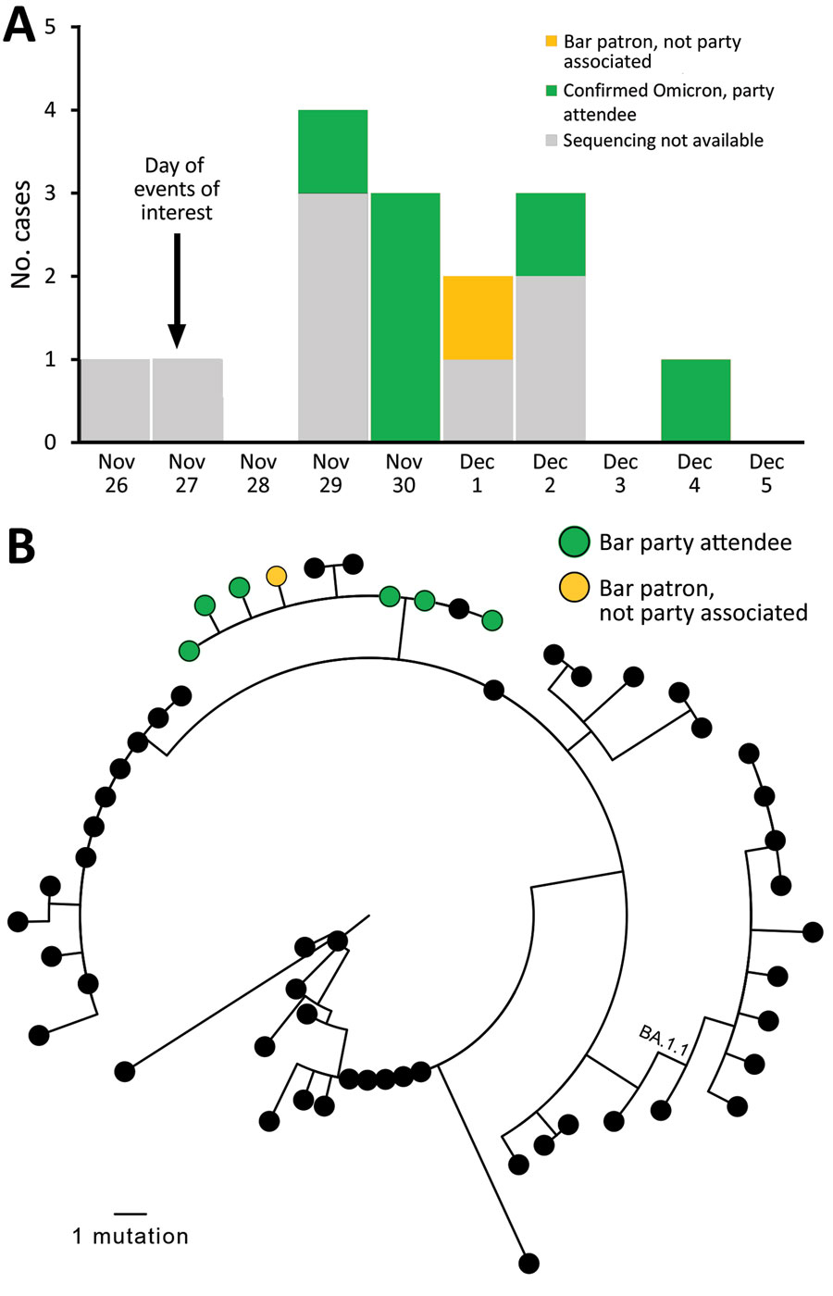
Figure
Figure. Cases in multistate (Colorado, Illinois, Louisiana, Missouri, Michigan) outbreak of infection with severe acute respiratory syndrome 2 Omicron variant after event in Chicago, Illinois, USA, November–December 2021. A) Cases over time. Sequencing results are shown, if available. B) Genetic relatedness of viruses isolated. Maximum-likelihood phylogeny of 7 sequenced Omicron samples in bar-associated outbreak (green and yellow) with 50 contextual sequences (black). Contextual sequences are a random sample of Omicron BA.1 and BA.1.1 sequences selected from all Omicron sequences in GISAID (https://www.gisaid.org) that were collected in the United States or before December 11, 2021, and had &gt;90% genome coverage. Random selection was performed by using CLC Genomics Workbench (QIAGEN, https://www.qiagen.com). No contextual sequences were from Illinois. GISAID accession numbers for all included sequences are listed in the Appendix. One outbreak-associated specimen was sequenced by a private laboratory and not uploaded to GISAID. Full-genome sequences were used for PhyML phylogenetic analysis (4), excluding 250 bp from genome ends and an error-prone region (reference positions 21492–21935). Outbreak sequences were identical to each other or contained a single-nucleotide substitution (T12000C, T22813G, T25414C) and clustered (with 3 contextual sequences) in a clade diverged by 2 nts from the closest other sequences. The 2 nt substitutions that defined the outbreak branch (C11950T, C28472T) were present in just 5.2% of contemporaneous Omicron sequences from the United States available on GISAID, indicating that all available outbreak sequences were closely genetically related.
Spencer H, Teran RA, Barbian HJ, Love S, Berg R, Black SR, et al. Multistate Outbreak of Infection with SARS-CoV-2 Omicron Variant after Event in Chicago, Illinois, USA, 2021. Emerg Infect Dis. 2022;28(6):1281-1283. https://doi.org/10.3201/eid2806.220411

