Slide 1
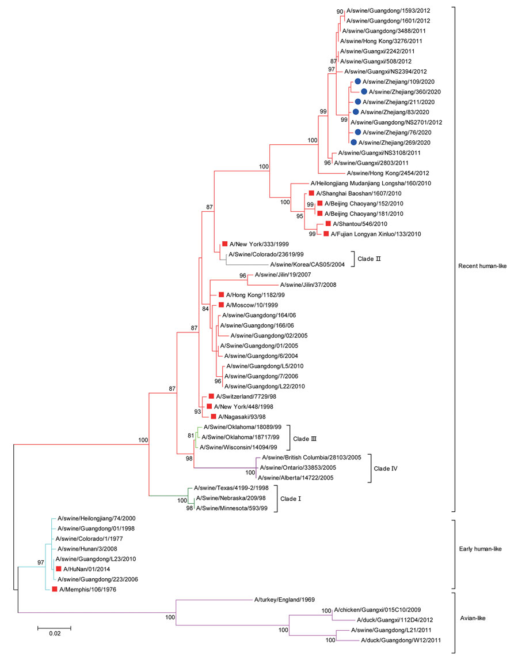
Figure 2
Figure 2. Maximum-likelihood phylogenetic tree of hemagglutinin genes of novel swine influenza A(H3N1) viruses from pigs on pig farms in 6 provinces of China (blue circles) and reference sequences from humans (red squares). The phylogeny of available sequences of related viruses from GenBank and GISAID database (https://www.gisaid.org) and the 6 HA genes sequenced in this study were inferred by using MEGA version 7 (https://www.megasoftware.net) under the general time-reversible plus gamma distribution model with 1,000 bootstrap replicates. Scale bar indicates substitutions per nucleotide.
Wang S, Wen F, Yu L, Wang J, Wang M, Yan J, et al. Potential Threats to Human Health from Eurasian Avian-Like Swine Influenza A(H1N1) Virus and Its Reassortants. Emerg Infect Dis. 2022;28(7):1489-1493. https://doi.org/10.3201/eid2807.211822

