Slide 1
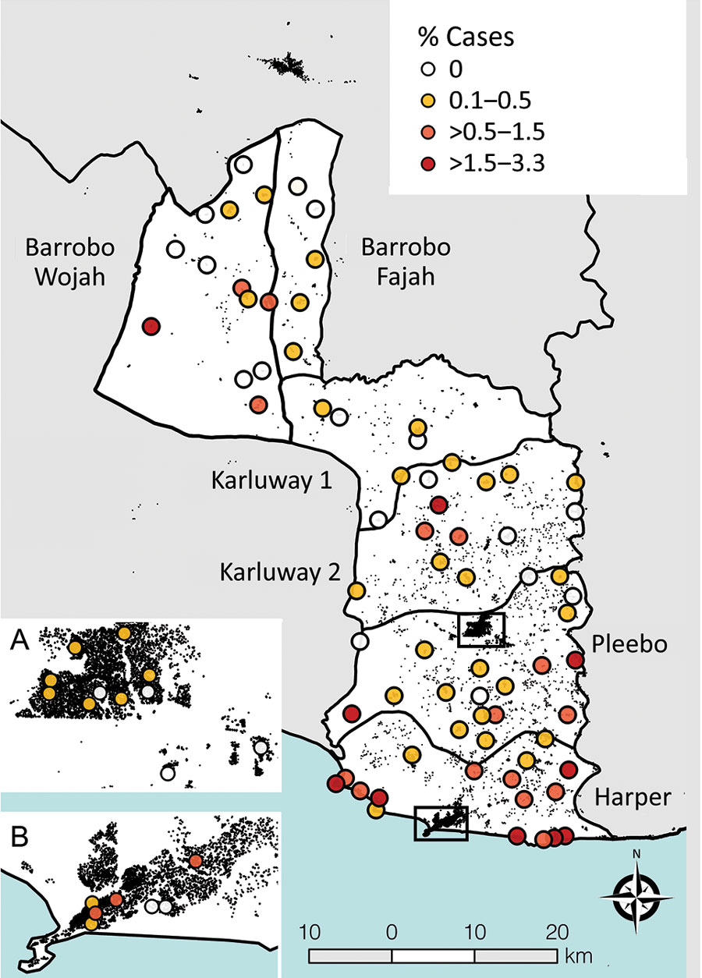
Figure 2
Figure 2. Cluster-level prevalence of all skin-presenting neglected tropical diseases combined, Maryland County, Liberia, June‒October 2018. Inset boxes show major urban areas Pleebo (A) and Harper (B). Black features are buildings (OpenStreetMap contributors) to highlight increasing rurality in northern districts.
Timothy J, Rogers E, Halliday KE, Mulbah T, Marks M, Zaizay Z, et al. Quantifying Population Burden and Effectiveness of Decentralized Surveillance Strategies for Skin-Presenting Neglected Tropical Diseases, Liberia. Emerg Infect Dis. 2022;28(9):1755-1764. https://doi.org/10.3201/eid2809.212126

