Slide 1
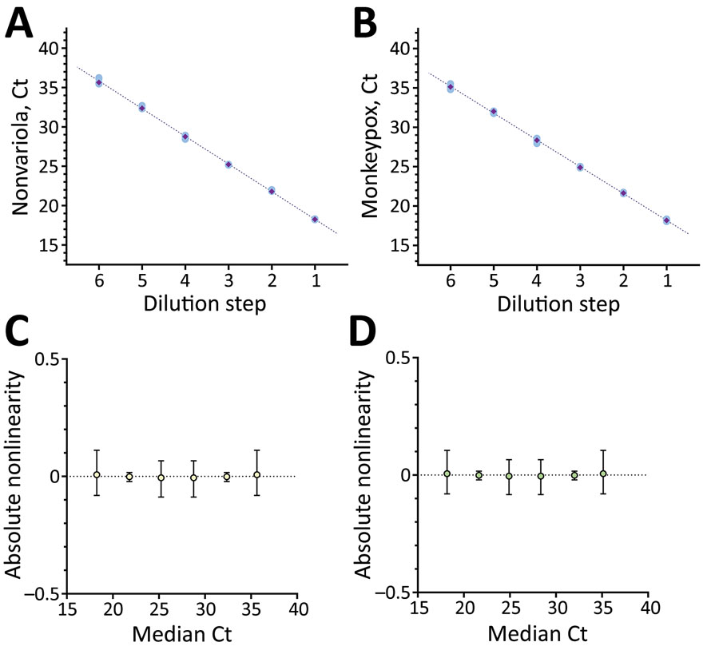
Figure 1
Figure 1. Linearity data for the dual-target monkeypox virus assay rapidly adapted from established high-throughput molecular testing infrastructure. A) Nonvariola orthopoxvirus target; B) monkeypox virus target; C) absolute Ct for nonvariola orthopox virus target; D) absolute Ct for monkeypox virus target. Linearity was determined by serial dilution of monkeypox virus reference material from cell culture supernatant of Congo Basin monkeypox strain collected in 1987. Analysis was performed on Validation Manager software (Finbiosoft, https://finbiosoft.com). Nonvariola orthopoxvirus slope was −3.52, r2 = 0.999; monkeypox virus slope was −3.40, r2 = 0.999. Ct, cycle threshold.
Nörz D, Tang H, Emmerich P, Giersch K, Fischer N, Schmiedel S, et al. Rapid Adaptation of Established High-Throughput Molecular Testing Infrastructure for Monkeypox Virus Detection. Emerg Infect Dis. 2022;28(9):1765-1769. https://doi.org/10.3201/eid2809.220917

