Slide 1
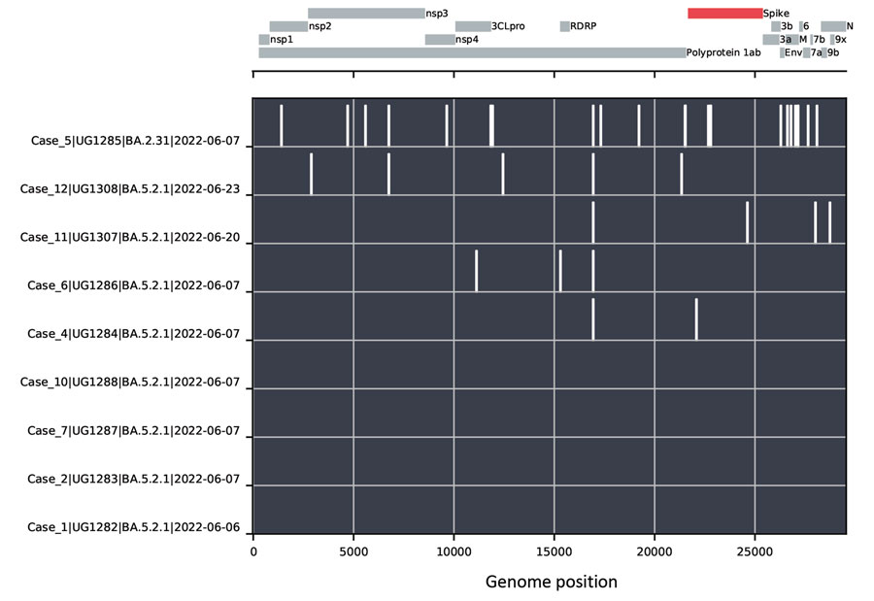
Figure
Figure. Nucleotide changes between SARS-CoV-2 genomes from a cluster of COVID-19–positive persons in Kyamulibwa, Kalungu District, rural Uganda. The lower portion of the chart shows nucleotide differences from the case 1 genome, plotted as white bars. The absence of bars in the BA.5.2.1 genomes from cases 1, 2, 7, and 10 indicates identical sequences. Case 5 was determined to be lineage BA.2.31, and cases 4, 6, 11, and 12 genomes demonstrated virus variants of lineage BA.5.2.1 distinct from the genomes from cases 1, 2, 7, and 10. A schematic of the SARS-CoV-2 genome is shown in the top portion of the chart, with protein coding regions marked.
Mugisha J, Mpairwe B, Newton R, Cotten M, Phan M. SARS-CoV-2 Omicron BA.5 Infections in Vaccinated Persons, Rural Uganda. Emerg Infect Dis. 2023;29(1):224-226. https://doi.org/10.3201/eid2901.220981

