Slide 1
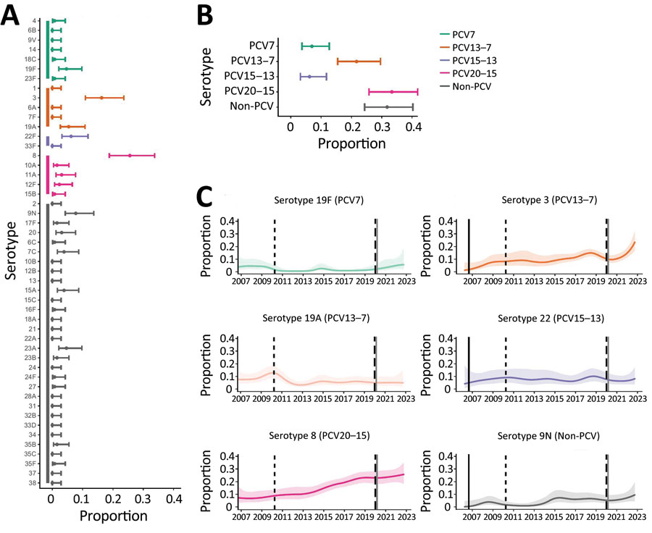
Figure 2
Figure 2. Distribution of pneumococcal serotypes in hospitalized patients after emergence of SARS-CoV-2. A, B) Proportion of pneumococcal disease attributable to each serotype (A) and PCV vaccine group (B) from 129 case-patients in Bristol, UK, hospitalized during January 1, 2021‒December 31, 2022. C) Binomial (one versus others) time series models showing the percentage of disease during January 2006‒December 2022 attributable to each of the 6 most common pneumococcal serotypes. Solid lines indicate smoothed point estimates; error bars/shaded areas indicate 95% CIs. The 95% CIs in panels A and B do not coincide exactly with those in panel C because they represent different length time periods and use different models. Additional data and time points are available in Table 2. PCV, pneumococcal conjugate vaccine.
Hyams C, Challen R, Hettle D, Amin-Chowdhury Z, Grimes C, Ruffino G, et al. Serotype Distribution and Disease Severity in Adults Hospitalized with Streptococcus pneumoniae Infection, Bristol and Bath, UK, 2006‒2022. Emerg Infect Dis. 2023;29(10):1953-1964. https://doi.org/10.3201/eid2910.230519

