Slide 1
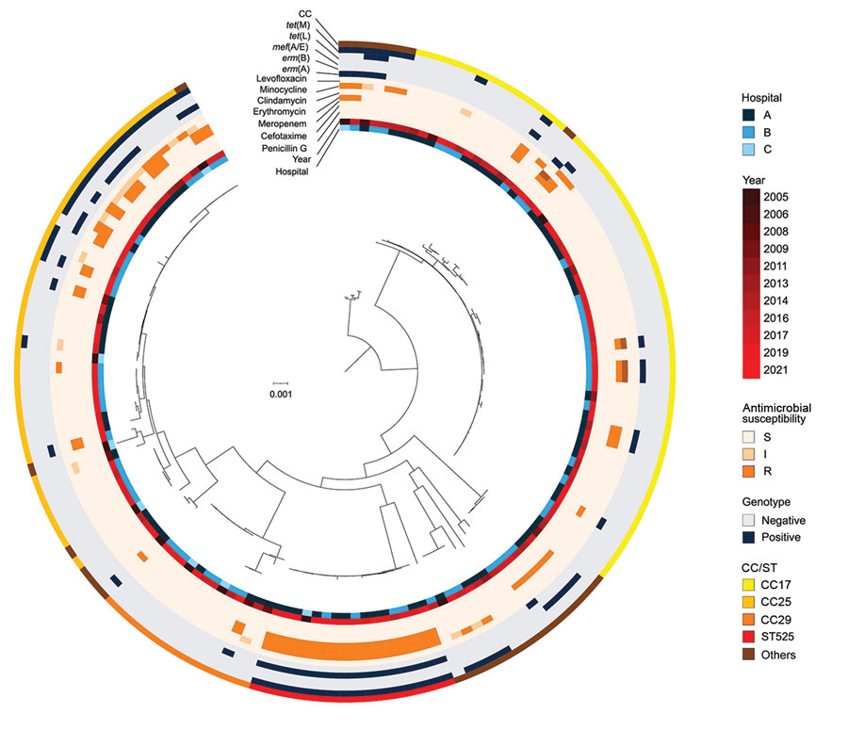
Figure 3
Figure 3. Phylogenetic tree of multidrug-resistant Streptococcus dysgalactiae subspecies equisimilis causing bacteremia, Japan, 2005–2021. From the center out, rings indicate hospital site, year of isolation, antimicrobial resistance, genotypes, and CC for each isolate. Scale bar indicates nucleotide substitutions per site. CC, clonal complex; I, intermediate; R, resistant; S, susceptible; ST, sequence type.
Shinohara K, Murase K, Tsuchido Y, Noguchi T, Yukawa S, Yamamoto M, et al. Clonal Expansion of Multidrug-Resistant Streptococcus dysgalactiae Subspecies equisimilis Causing Bacteremia, Japan, 2005–2021. Emerg Infect Dis. 2023;29(3):528-539. https://doi.org/10.3201/eid2903.221060

