Slide 1
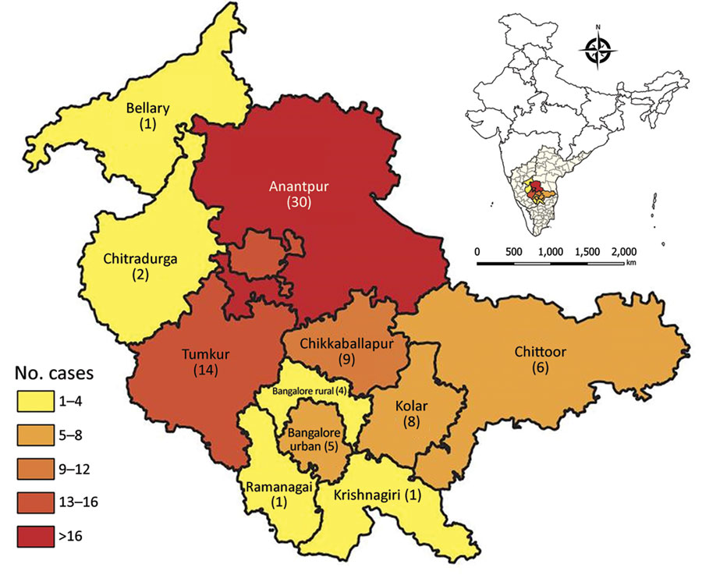
Figure 4
Figure 4. District-wise distribution of children with scrub typhus manifesting as acute encephalitis syndrome, southern India. Number of children from each district with scrub typhus manifesting as acute encephalitis syndrome is indicated. The 3 recruiting hospitals and the coordinating center are located in Bangalore urban. Inset shows location of study area in India.
Damodar T, Singh B, Prabhu N, Marate S, Gowda VK, Lalitha A, et al. Association of Scrub Typhus in Children with Acute Encephalitis Syndrome and Meningoencephalitis, Southern India. Emerg Infect Dis. 2023;29(4):711-722. https://doi.org/10.3201/eid2904.221157

