Slide 1
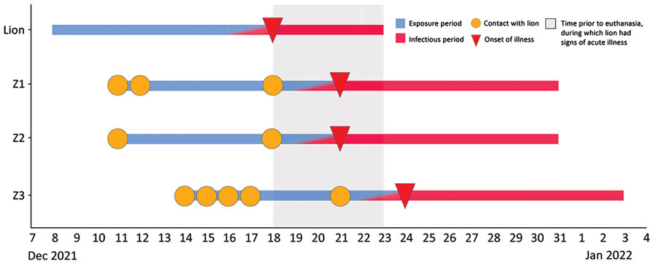
Figure 2
Figure 2. Timeline of probable transmission of SARS-CoV-2 from an African lion to zoo employees, Indiana, USA, 2021–2022. The lion’s likely exposure period was December 8–17, and his infectious period was December 16 through euthanasia on December 23. During the lion’s infectious period, employees Z1 and Z2 each had a single day of cranial contact with him, coinciding with the day of the lion’s illness onset. Z3 had cranial contact with the lion on 3 occasions during his infectious period. Figure highlights the lack of overlap between Z1 and Z2’s infectious period and the lion’s exposure period, and between Z3′s infectious period and Z1 and Z2’s exposure periods.
Siegrist AA, Richardson KL, Ghai RR, Pope B, Yeadon J, Culp B, et al. Probable Transmission of SARS-CoV-2 from African Lion to Zoo Employees, Indiana, USA, 2021. Emerg Infect Dis. 2023;29(6):1102-1108. https://doi.org/10.3201/eid2906.230150

