Slide 1
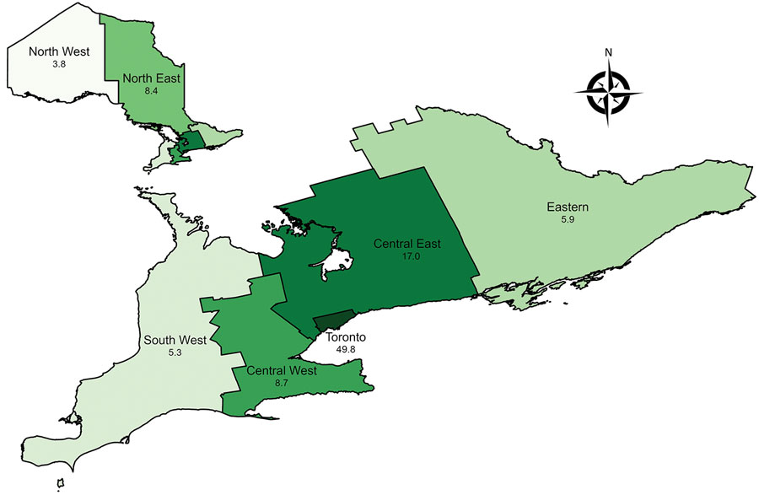
Figure 2
Figure 2. Prevalence of nontuberculous mycobacterial pulmonary disease (standard definition) by Ontario health region, Ontario, Canada, 2020. Numbers below region names indicate number of cases per 100,000 population.
Marras TK, Nelson P, Peci A, Richard-Greenblatt M, Brode S, Sullivan A, et al. Pulmonary Nontuberculous Mycobacteria, Ontario, Canada, 2020. Emerg Infect Dis. 2023;29(7):1415-1419. https://doi.org/10.3201/eid2907.230216

