Slide 1
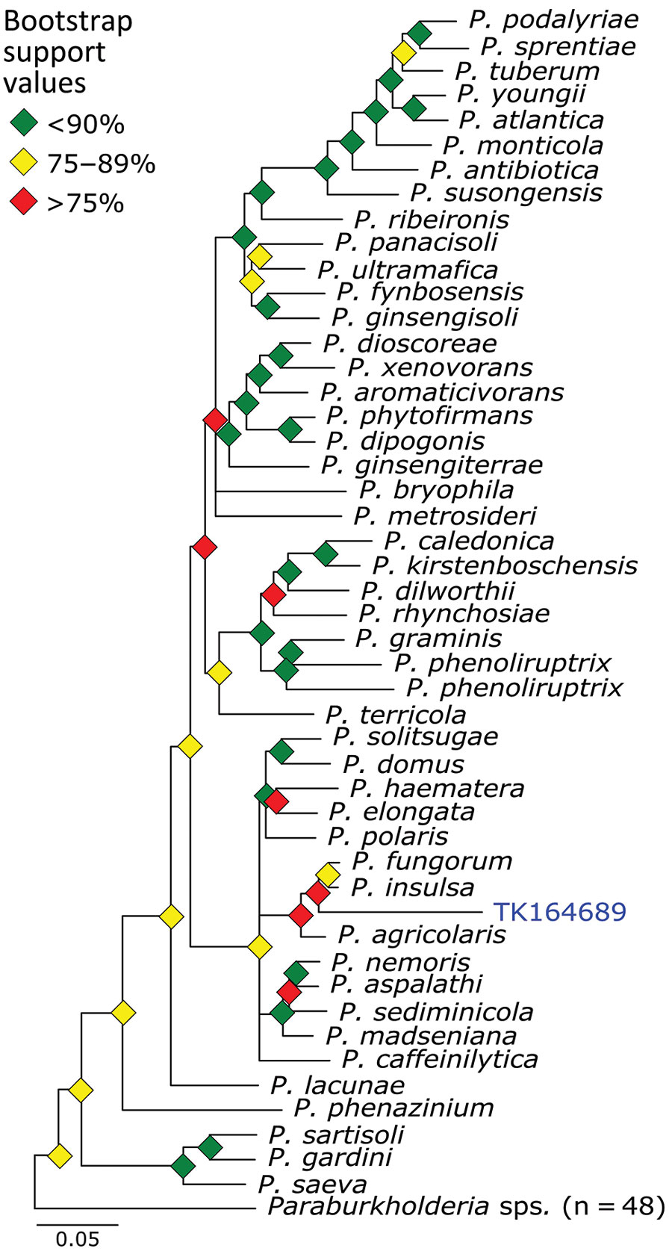
Figure 7
Figure 7. Phylogenetic analysis of Paraburkholderia using museum archived samples for probe panel for prospecting zoonotic pathogens by using targeted DNA enrichment. Blue indicates museum archived samples; museum accession numbers are given (Table 1). Branches with &gt;50% bootstrap support were collapsed. Nodal support is indicated by color coded diamonds. Scale bar indicates. nucleotide substitutions per site. Assembly accession numbers (e.g., GCA90237446) and tree files are available from https://doi.org/10.5281/zenodo.8014941.
Enabulele EE, Le Clec’h W, Roberts EK, Thompson CW, McDonough MM, Ferguson AW, et al. Prospecting for Zoonotic Pathogens by Using Targeted DNA Enrichment. Emerg Infect Dis. 2023;29(8):1566-1579. https://doi.org/10.3201/eid2908.221818

