Slide 1
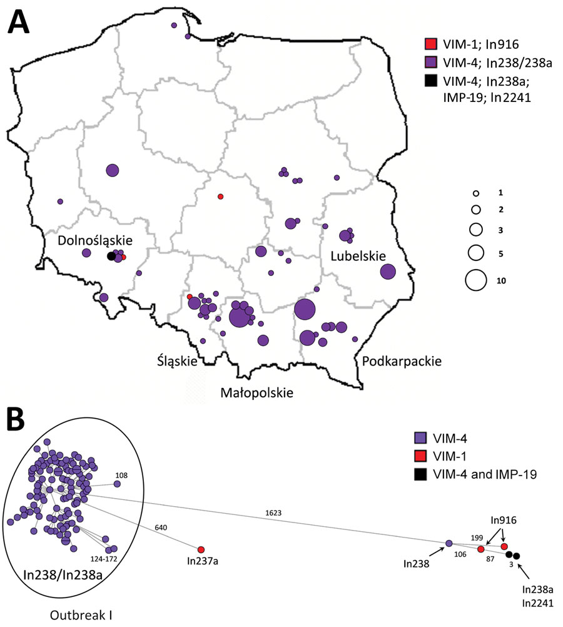
Figure 2
Figure 2. Geographic distribution and clonal analysis of Enterobacter hormaechei clonal complex 90 (ST90 and ST1762) in Poland, 2006–2019. A) Geographic distribution of the isolates; main administrative regions are labeled. Circles represent medical centers where the isolates were recorded. Sizes of the circles are proportional to numbers of cases of infection. B) SNP-based minimum-spanning tree of the isolates. Lengths of branches are related to numbers of SNPs between linked isolates. Numbers of SNPs are indicated above the branches or next to the dots. SNP, single nucleotide polymorphism; ST, sequence type.
Izdebski R, Biedrzycka M, Urbanowicz P, Żabicka D, Gniadkowski M. Genome-Based Epidemiologic Analysis of VIM/IMP Carbapenemase-Producing Enterobacter spp., Poland. Emerg Infect Dis. 2023;29(8):1618-1626. https://doi.org/10.3201/eid2908.230199

