Slide 1
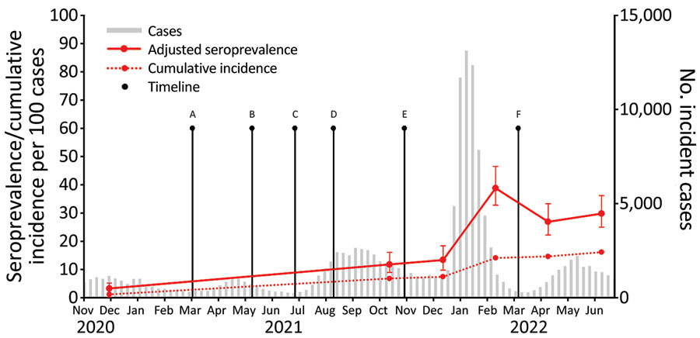
Figure
Figure. Adjusted SARS-CoV-2 nucleocapsid seroprevalence, incident cases, and cumulative incidence in children, Oregon, USA, November 1, 2020–June 30, 2022. We calculated cumulative incidence estimates at the midpoint of each collection period and plotted adjusted seroprevalence estimates with 95% CIs (error bars). Incident cases and cumulative incidence are plotted by epidemiologic week. Points A through F denote key timepoints: A, all public schools required to offer in-person instruction for grades K–5 by March 29, 2021, and grades 6–12 by April 19, 2021; B, COVID-19 vaccine available for children 12–15 years of age on May 12, 2021; C, statewide mask mandates lifted on June 30, 2021; D, statewide mask mandates reinstated on Aug 13, 2021; E, COVID-19 vaccine available for children 5–11 years of age on November 2, 2021; F, statewide mask mandates were lifted on March 12, 2022. Incident cases and case-based cumulative incidence estimates were calculated at the midpoint of each collection period and are obtained from pediatric COVID-19 cases reported to Oregon Health Authority since the beginning of the pandemic.
Falender RA, Mitchell PG, Guzman-Cottrill JA, Cieslak PR, Sutton M. Pediatric SARS-CoV-2 Seroprevalence, Oregon, USA, November 1, 2020–June 30, 2022. Emerg Infect Dis. 2023;29(8):1672-1675. https://doi.org/10.3201/eid2908.230471

