Slide 1
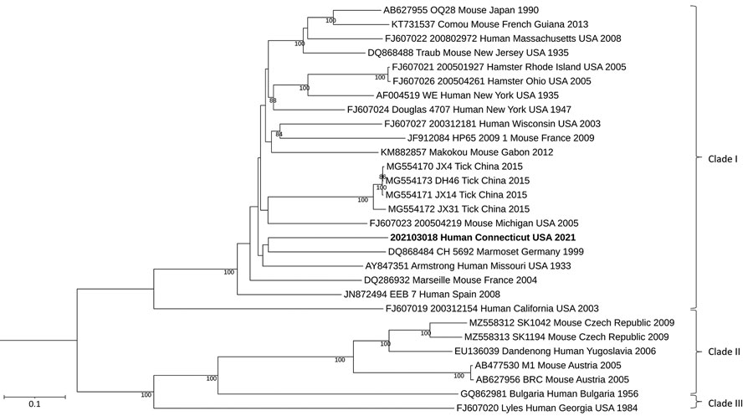
Figure 1
Figure 1. Maximum-likelihood analysis of the full large genome segment of lymphocytic choriomeningitis virus (LCMV) sample from a patient in Connecticut, USA (bold), compared with reference sequences. Branch nodes provide the bootstrap support values, as a percentage. Clades are indicated at right, and GenBank accession numbers are provided for reference sequences. Scale bar indicates number of substitutions per site.
Dyal J, Gandhi S, Cossaboom CM, Leach A, Patel K, Golden M, et al. Lymphocytic Choriomeningitis Virus in Person Living with HIV, Connecticut, USA, 2021. Emerg Infect Dis. 2023;29(9):1886-1889. https://doi.org/10.3201/eid2909.230087

